Slide 1
CAP476:
Data Communication and Networking
Unit-I
TCP/IP model

Slide 2
TCP/IP model
Developed before OSI model
Consists of four layers
Application layer included upper layers
Layers provide specific functions
Hierarchical protocol modules

Slide 3
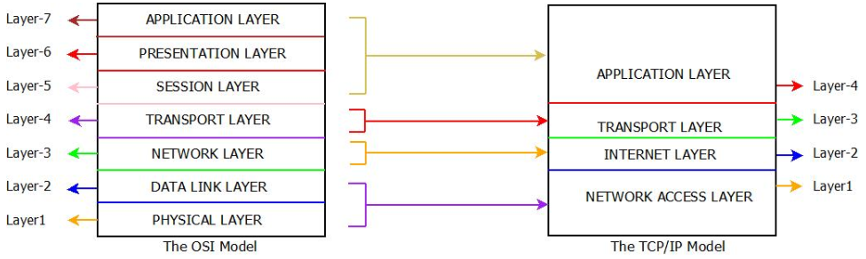

Slide 4
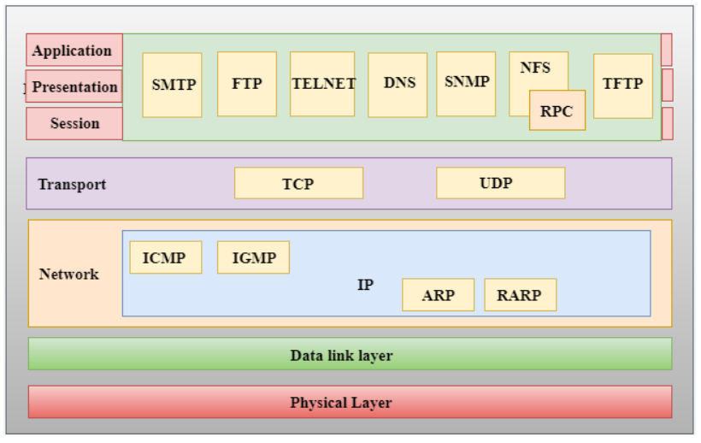
Functions of TCP/IP layer

Slide 5
Network Access Layer
Combines Physical and Data Link
Defines how data is sent
Transmits data on same network
Encapsulates IP datagram in frames
Uses Ethernet, Token Ring, Frame Relay

Slide 6
Internet Layer
Second layer of TCP/IP model
Responsible for packet sending
Works regardless of route path
Uses IP, ARP, ICMP protocols
Handles addressing and routing

Slide 7
Internet Protocol (IP) Functions
Implements logical IP addresses
Host-to-host communication path
Encapsulates data as IP datagram
Fragmentation and reassembly tasks
Routing between distant networks

Slide 8
Address Resolution Protocol (ARP)
Finds physical address from IP
Network layer protocol function
ARP request broadcasted on network
ARP reply sent by recipient
Physical address cached in memory

Slide 9
ICMP Protocol
Internet Control Message Protocol
Sends notifications on datagram issues
Informs sender about undeliverable data
Uses ICMP Test and Reply
Reports problems, correction sender's job

Slide 10
Transport Layer Protocols
Ensures error-free delivery
Facilitates conversation between hosts
Provides interface to network
Includes TCP, UDP, SCTP protocols
Reliable and unreliable service

Slide 11
User Datagram Protocol (UDP)
Connectionless transport service
Unreliable error detection
Contains source and destination ports
Total length and checksum fields
Does not identify lost packets

Slide 12
Transmission Control Protocol (TCP)
Reliable, connection-oriented service
Virtual circuit between sender and receiver
Detects and retransmits errors
Segments data with sequence numbers
Reorders segments at destination

Slide 13
Application Layer
Topmost layer in TCP/IP
Provides network services to users
Handles resource allocation issues
Not an application itself
Interfaces with user applications

Slide 14
Functions of Application Layer
File transfer, access, management
Email forwarding and storage
Provides directory services globally
Supports network transparency concepts
Manages distributed database sources

Slide 15
Application Layer Protocols
HTTP: Hypertext Transfer Protocol
SNMP: Network Management Protocol
SMTP: Simple Mail Transfer Protocol
DNS: Domain Name System
TELNET: Terminal Network Protocol/Telecommunication Network

Slide 16
THANK YOU

